Slide 1
Микроконтроллеры в электроприводе
Проектирование системы управления регулируемым электроприводом с помощью частотного преобразователя Delta VFD-B
Часть 1 – Управление с компьютера

Slide 2
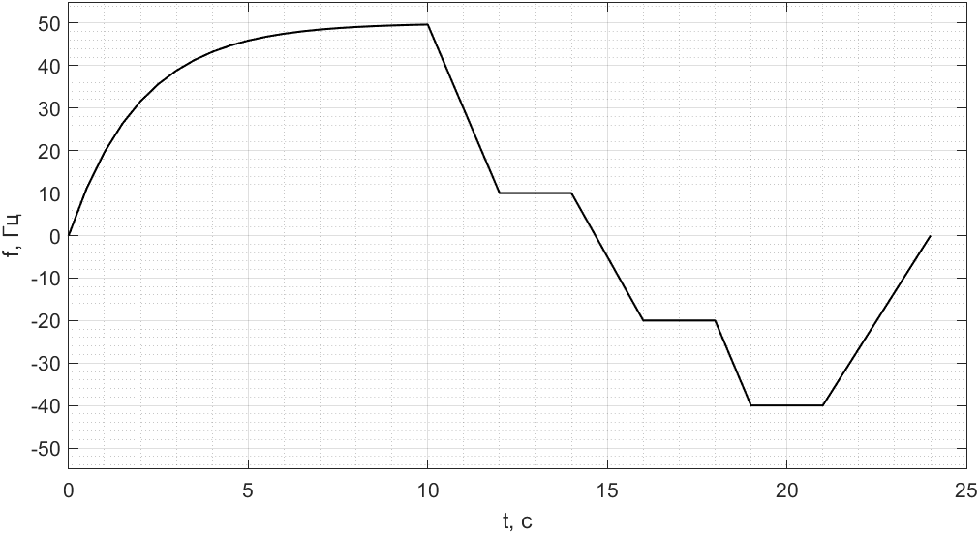
Задание

Slide 3
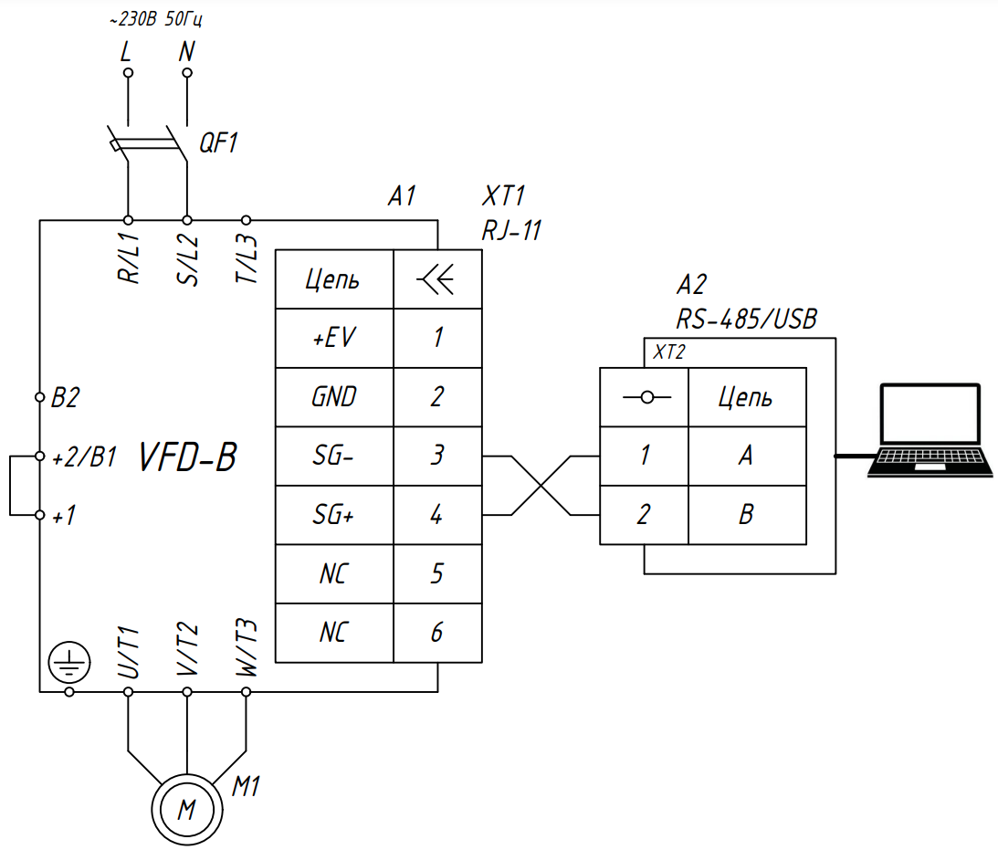

Slide 4
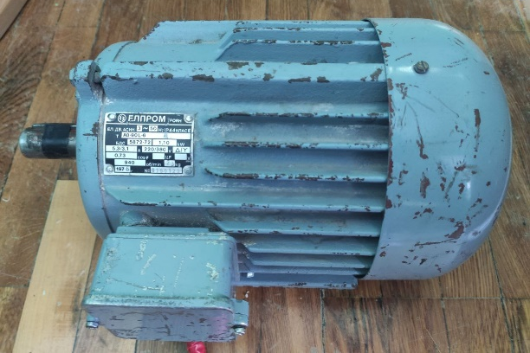
Тип: АДКЗ.
Название: A0-90L-6.
Производитель: ЕЛПРОМ троян.
Питание 3Ф~50Гц.
Мощность: 1,1 кВт.
Соединение: Δ/Y.
Напряжение: 220/380 В.
Ток: 5,3/3,1 А.
Коэффициент мощности: 0,73.
Частота вращения: 940 об/мин.
Степень защиты: IP44.
Класс изоляции: E.

Slide 5
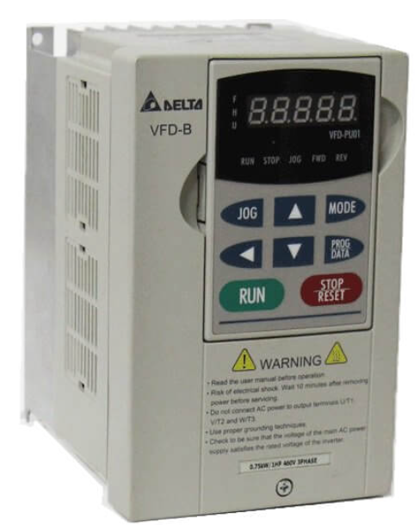
Мощность: 1,5 кВт.
Питание: 1Ф~220 В 50 Гц.
Выходная частота: 0,1–400 Гц.
Потребляемый ток: 9,4 А.

Slide 6
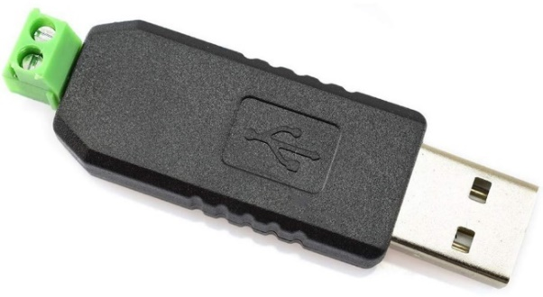
USB/RS-485
Полудуплексный режим
Автоматическое переключение с приёма на передачу

Slide 7
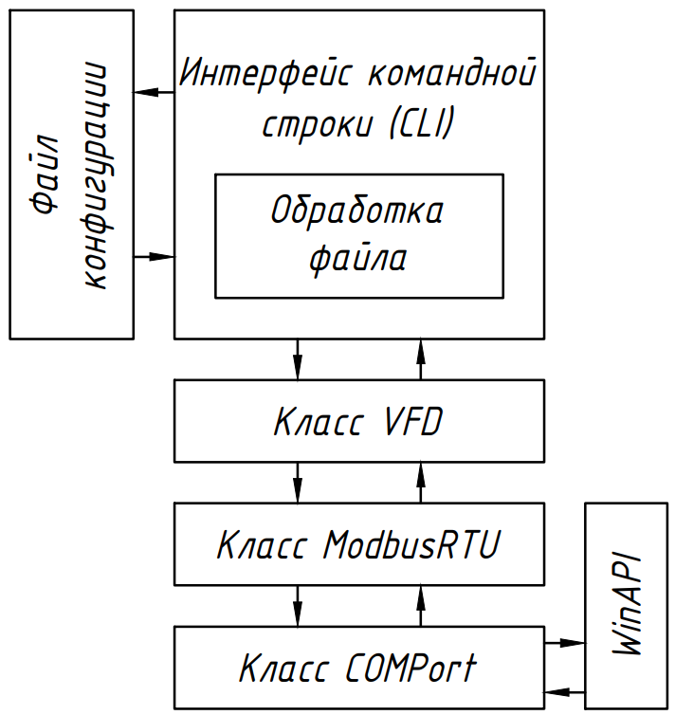

Slide 8


C/C++
Простота
Гибкость
Microsoft Visual Studio 2022
https://github.com/TAN4UKmax/microcontrollersCourseWork

Slide 9
assert
#include <cassert>
assert(<condition>);
#define NDEBUG
assert(("description string", <condition>));

Slide 10
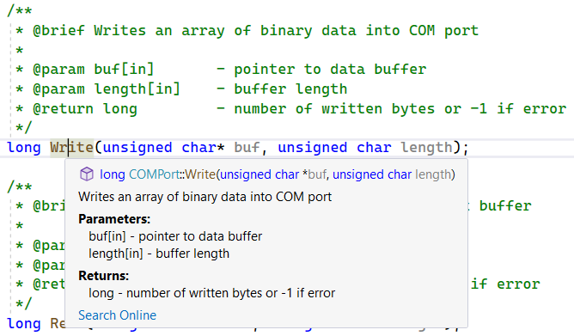
Doxygen
/**
* @file COMPort.h
* @author TAN4UK (tan4ukmak7@gmail.com)
* @brief Class for communication with COM port through WinAPI
* @version 0.1
* @date 2023-02-13
*
* @copyright Copyright (c) 2023 TAN4UK
*
*/

Slide 11
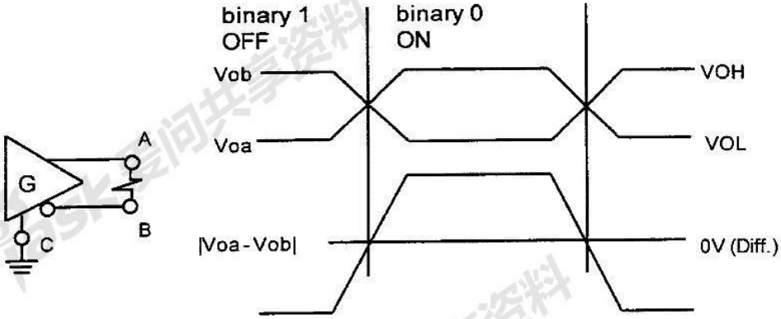
Интерфейс RS-485

Slide 12
Класс COM порта
public:
COMPort(
const char* name = "COM3",
unsigned long baud = 9600,
unsigned char dataBit = 8,
char parity = 'N',
unsigned char stopBit = 1);
COMPort(COMPort& other);
COMPort& operator =(COMPort& other);
COMPort(COMPort&& other) noexcept;
COMPort& operator =(COMPort&& other) noexcept;
~COMPort();
bool Open();
bool isOpen();
bool Close();
bool SetConfig(
unsigned long baud = 9600,
unsigned char dataBit = 8,
char parity = 'N',
unsigned char stopBit = 1);
bool SetReadTimeouts(
unsigned long interval = 0,
unsigned long multiplier = 0,
unsigned long constant = 1);
bool ClearReadBuffer();
long Write(unsigned char* buf, unsigned char length);
long Read(unsigned char* buf, unsigned char length);
};
#include <Windows.h>
class COMPort
{
private:
HANDLE hCOM;
DWORD error;
char name[9];
unsigned long baud;
unsigned char dataBit;
char parity;
unsigned char stopBit;
unsigned long tInterval;
unsigned long tMultiplier;
unsigned long tConstant;
bool WriteDCB();
bool TimeoutsSetup();

Slide 13
hCOM – дескриптор открытого порта;
error – последняя ошибка порта;
name – массив символов для хранения имени порта;
baud – скорость передачи, бод/с;
dataBit – количество бит данных;
parity – тип проверки четности;
stopBit – количество стоповых битов;
tInterval – максимальный таймаут между приемом двух байт, мс;
tMultiplier – множитель для расчета общего таймаута чтения;
tConstant – константа для расчета общего таймаута чтения, мс.
#include <Windows.h>
class COMPort
{
private:
HANDLE hCOM;
DWORD error;
char name[9];
unsigned long baud;
unsigned char dataBit;
char parity;
unsigned char stopBit;
unsigned long tInterval;
unsigned long tMultiplier;
unsigned long tConstant;
bool WriteDCB();
bool TimeoutsSetup();

Slide 14
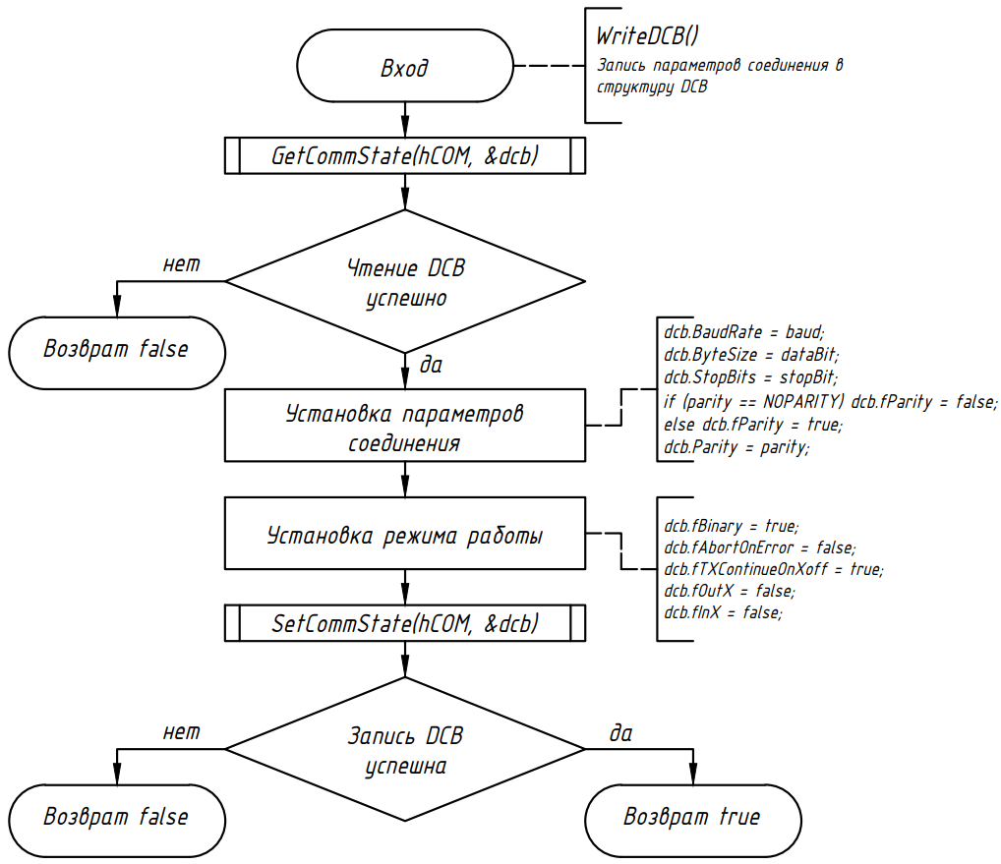
#include <Windows.h>
class COMPort
{
private:
HANDLE hCOM;
DWORD error;
char name[9];
unsigned long baud;
unsigned char dataBit;
char parity;
unsigned char stopBit;
unsigned long tInterval;
unsigned long tMultiplier;
unsigned long tConstant;
bool WriteDCB();
bool TimeoutsSetup();

Slide 15
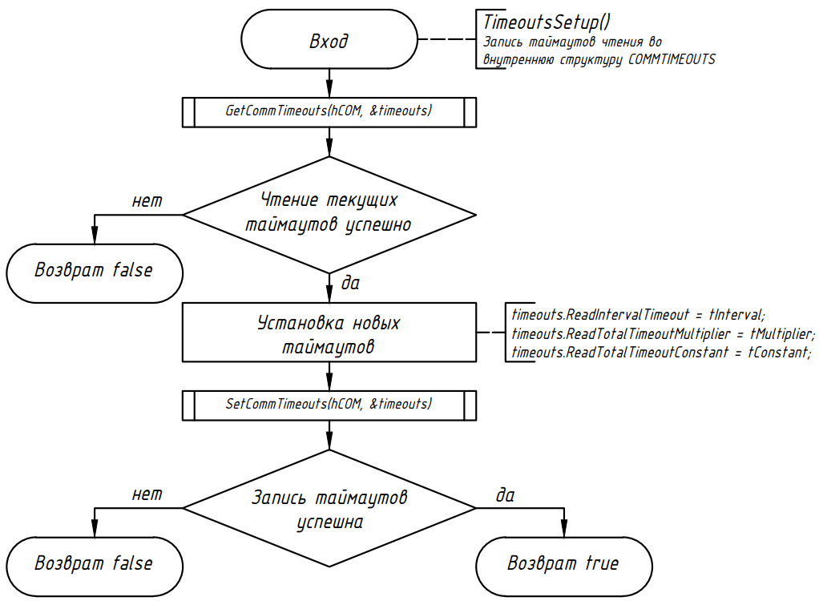
#include <Windows.h>
class COMPort
{
private:
HANDLE hCOM;
DWORD error;
char name[9];
unsigned long baud;
unsigned char dataBit;
char parity;
unsigned char stopBit;
unsigned long tInterval;
unsigned long tMultiplier;
unsigned long tConstant;
bool WriteDCB();
bool TimeoutsSetup();

Slide 16
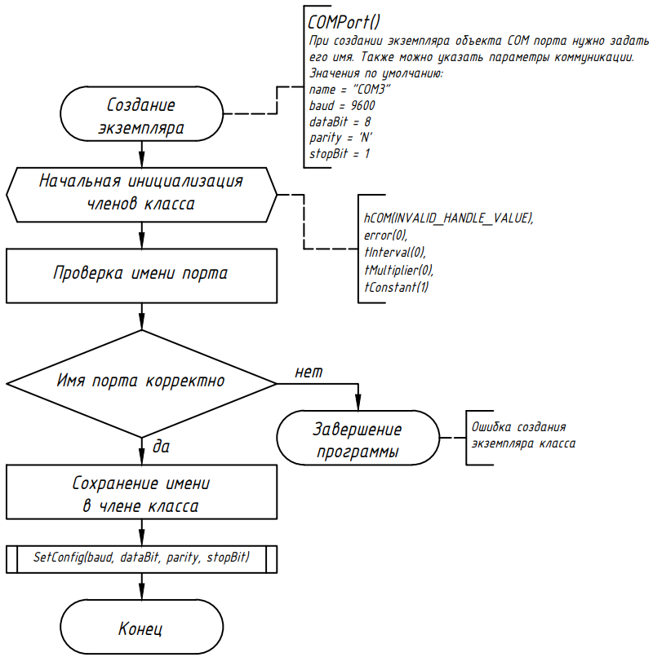
public:
COMPort(
const char* name = "COM3",
unsigned long baud = 9600,
unsigned char dataBit = 8,
char parity = 'N',
unsigned char stopBit = 1);
COMPort(COMPort& other);
COMPort& operator =(COMPort& other);
COMPort(COMPort&& other) noexcept;
COMPort& operator =(COMPort&& other) noexcept;
~COMPort();
bool Open();
bool isOpen();
bool Close();
bool SetConfig(
unsigned long baud = 9600,
unsigned char dataBit = 8,
char parity = 'N',
unsigned char stopBit = 1);
bool SetReadTimeouts(
unsigned long interval = 0,
unsigned long multiplier = 0,
unsigned long constant = 1);
bool ClearReadBuffer();
long Write(unsigned char* buf, unsigned char length);
long Read(unsigned char* buf, unsigned char length);
};

Slide 17
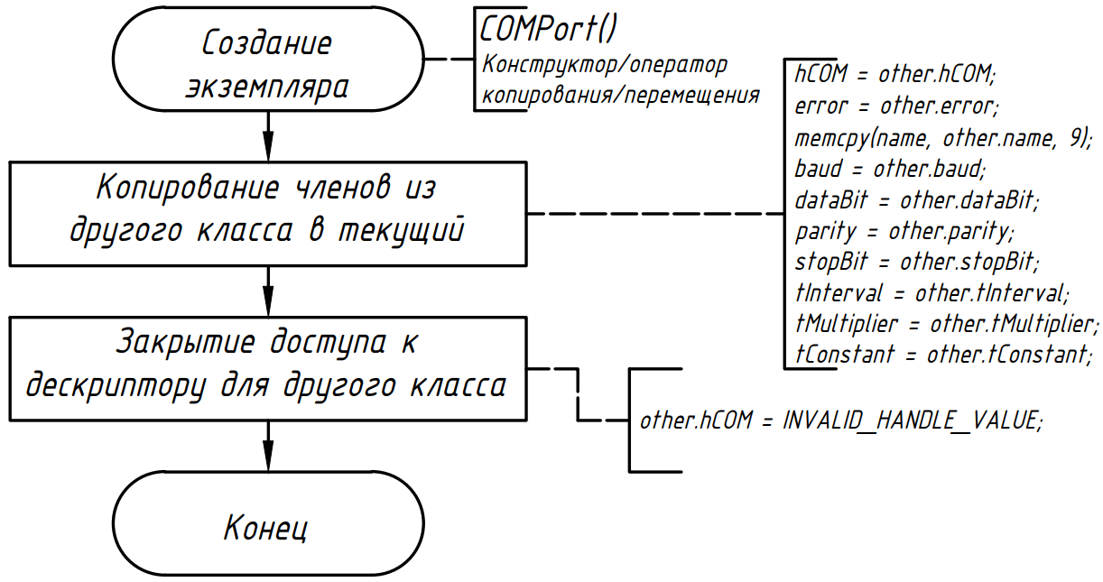
public:
COMPort(
const char* name = "COM3",
unsigned long baud = 9600,
unsigned char dataBit = 8,
char parity = 'N',
unsigned char stopBit = 1);
COMPort(COMPort& other);
COMPort& operator =(COMPort& other);
COMPort(COMPort&& other) noexcept;
COMPort& operator =(COMPort&& other) noexcept;
~COMPort();
bool Open();
bool isOpen();
bool Close();
bool SetConfig(
unsigned long baud = 9600,
unsigned char dataBit = 8,
char parity = 'N',
unsigned char stopBit = 1);
bool SetReadTimeouts(
unsigned long interval = 0,
unsigned long multiplier = 0,
unsigned long constant = 1);
bool ClearReadBuffer();
long Write(unsigned char* buf, unsigned char length);
long Read(unsigned char* buf, unsigned char length);
};

Slide 18
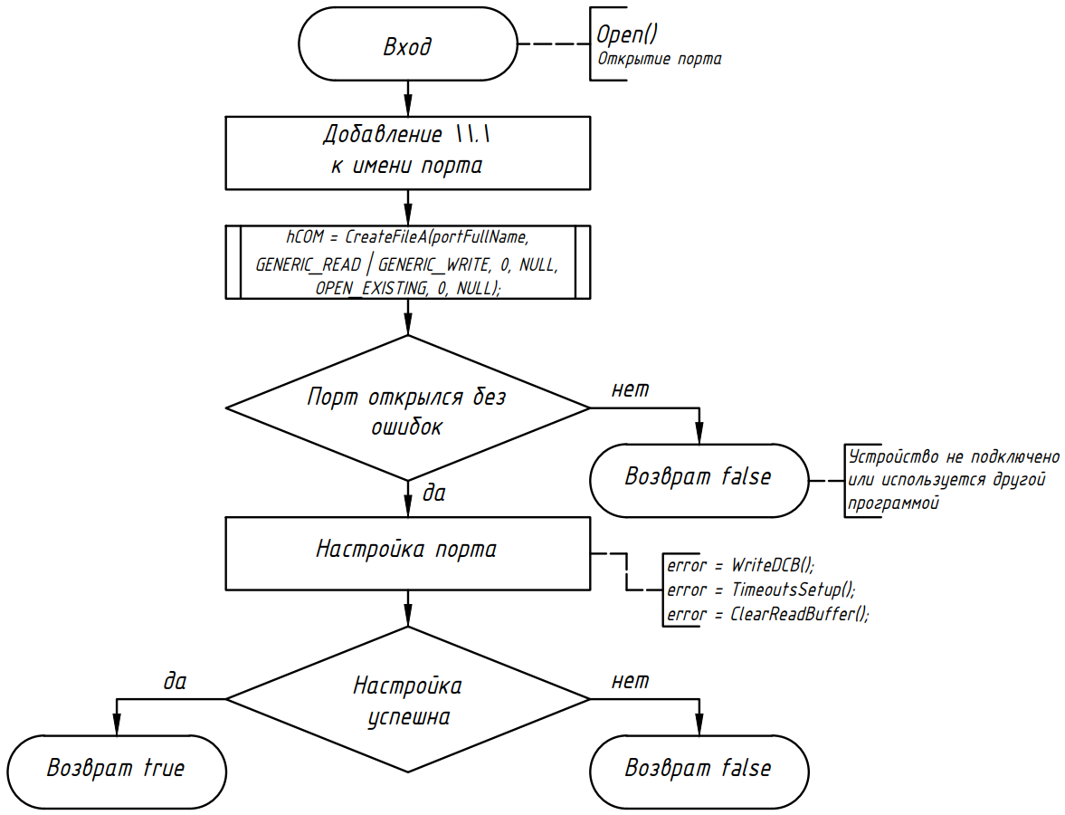
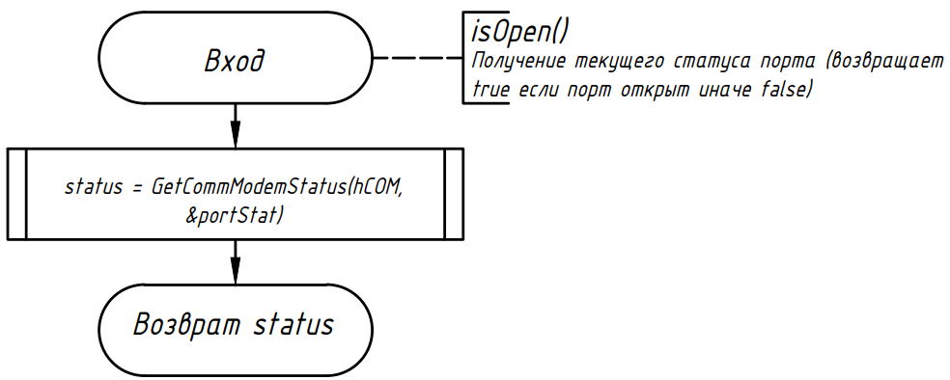
public:
COMPort(
const char* name = "COM3",
unsigned long baud = 9600,
unsigned char dataBit = 8,
char parity = 'N',
unsigned char stopBit = 1);
COMPort(COMPort& other);
COMPort& operator =(COMPort& other);
COMPort(COMPort&& other) noexcept;
COMPort& operator =(COMPort&& other) noexcept;
~COMPort();
bool Open();
bool isOpen();
bool Close();
bool SetConfig(
unsigned long baud = 9600,
unsigned char dataBit = 8,
char parity = 'N',
unsigned char stopBit = 1);
bool SetReadTimeouts(
unsigned long interval = 0,
unsigned long multiplier = 0,
unsigned long constant = 1);
bool ClearReadBuffer();
long Write(unsigned char* buf, unsigned char length);
long Read(unsigned char* buf, unsigned char length);
};

Slide 19
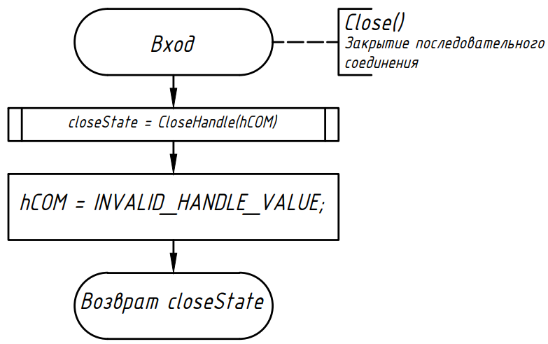
public:
COMPort(
const char* name = "COM3",
unsigned long baud = 9600,
unsigned char dataBit = 8,
char parity = 'N',
unsigned char stopBit = 1);
COMPort(COMPort& other);
COMPort& operator =(COMPort& other);
COMPort(COMPort&& other) noexcept;
COMPort& operator =(COMPort&& other) noexcept;
~COMPort();
bool Open();
bool isOpen();
bool Close();
bool SetConfig(
unsigned long baud = 9600,
unsigned char dataBit = 8,
char parity = 'N',
unsigned char stopBit = 1);
bool SetReadTimeouts(
unsigned long interval = 0,
unsigned long multiplier = 0,
unsigned long constant = 1);
bool ClearReadBuffer();
long Write(unsigned char* buf, unsigned char length);
long Read(unsigned char* buf, unsigned char length);
};

Slide 20
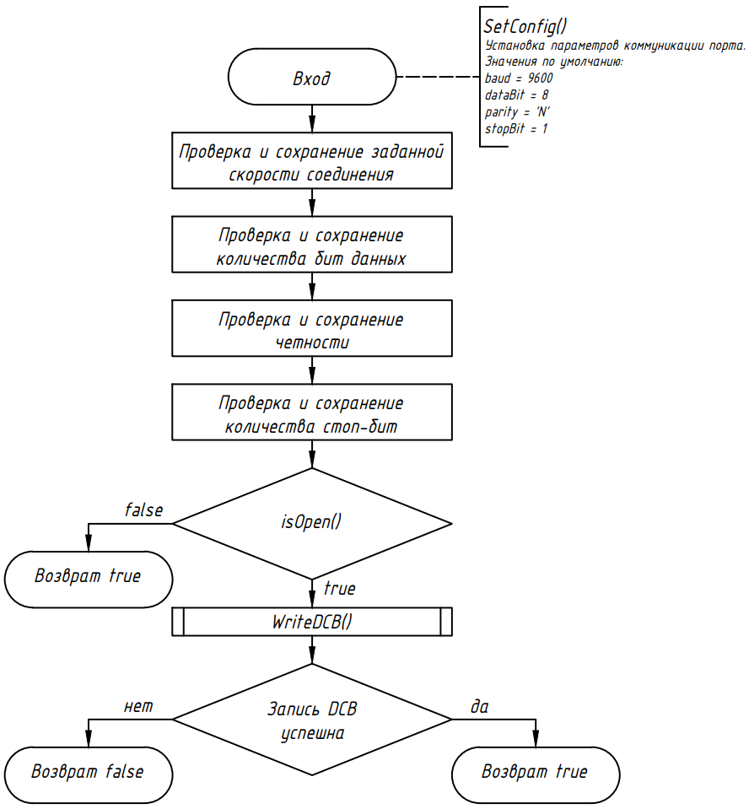
public:
COMPort(
const char* name = "COM3",
unsigned long baud = 9600,
unsigned char dataBit = 8,
char parity = 'N',
unsigned char stopBit = 1);
COMPort(COMPort& other);
COMPort& operator =(COMPort& other);
COMPort(COMPort&& other) noexcept;
COMPort& operator =(COMPort&& other) noexcept;
~COMPort();
bool Open();
bool isOpen();
bool Close();
bool SetConfig(
unsigned long baud = 9600,
unsigned char dataBit = 8,
char parity = 'N',
unsigned char stopBit = 1);
bool SetReadTimeouts(
unsigned long interval = 0,
unsigned long multiplier = 0,
unsigned long constant = 1);
bool ClearReadBuffer();
long Write(unsigned char* buf, unsigned char length);
long Read(unsigned char* buf, unsigned char length);
};

Slide 21
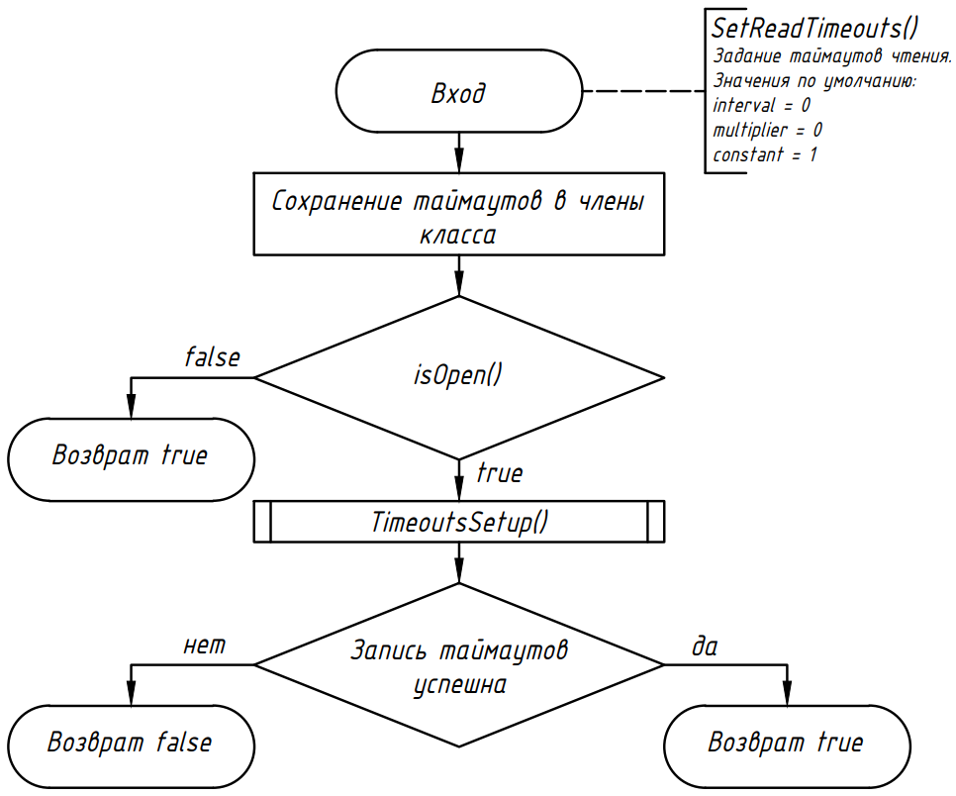
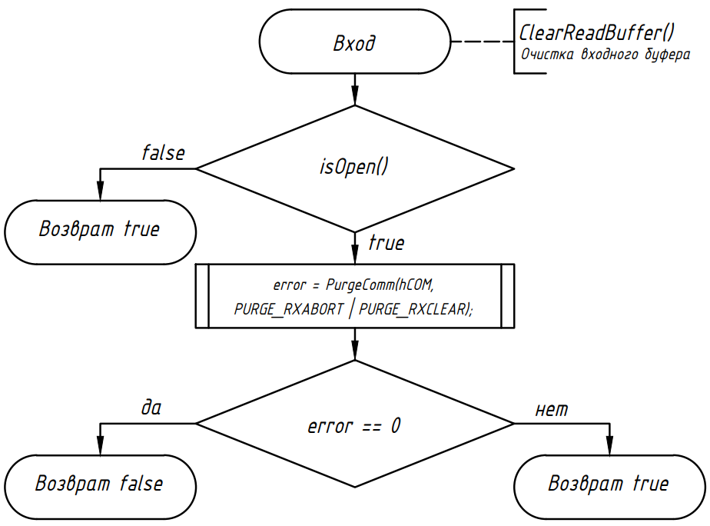
public:
COMPort(
const char* name = "COM3",
unsigned long baud = 9600,
unsigned char dataBit = 8,
char parity = 'N',
unsigned char stopBit = 1);
COMPort(COMPort& other);
COMPort& operator =(COMPort& other);
COMPort(COMPort&& other) noexcept;
COMPort& operator =(COMPort&& other) noexcept;
~COMPort();
bool Open();
bool isOpen();
bool Close();
bool SetConfig(
unsigned long baud = 9600,
unsigned char dataBit = 8,
char parity = 'N',
unsigned char stopBit = 1);
bool SetReadTimeouts(
unsigned long interval = 0,
unsigned long multiplier = 0,
unsigned long constant = 1);
bool ClearReadBuffer();
long Write(unsigned char* buf, unsigned char length);
long Read(unsigned char* buf, unsigned char length);
};

Slide 22
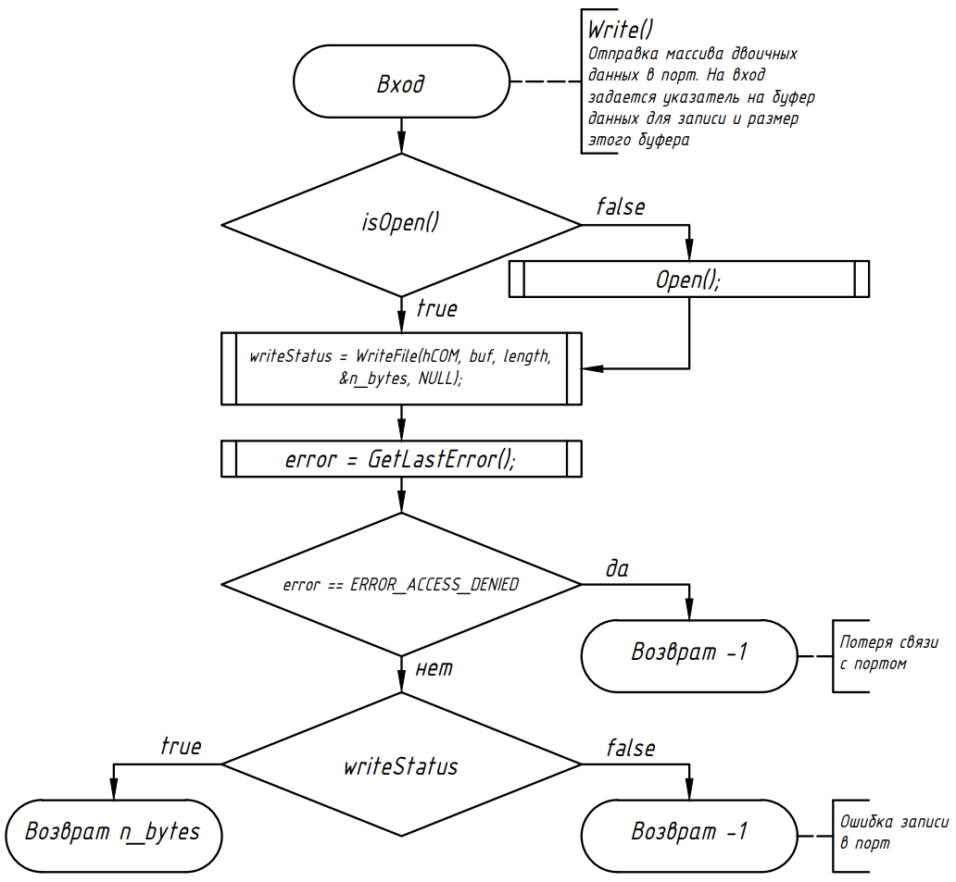
public:
COMPort(
const char* name = "COM3",
unsigned long baud = 9600,
unsigned char dataBit = 8,
char parity = 'N',
unsigned char stopBit = 1);
COMPort(COMPort& other);
COMPort& operator =(COMPort& other);
COMPort(COMPort&& other) noexcept;
COMPort& operator =(COMPort&& other) noexcept;
~COMPort();
bool Open();
bool isOpen();
bool Close();
bool SetConfig(
unsigned long baud = 9600,
unsigned char dataBit = 8,
char parity = 'N',
unsigned char stopBit = 1);
bool SetReadTimeouts(
unsigned long interval = 0,
unsigned long multiplier = 0,
unsigned long constant = 1);
bool ClearReadBuffer();
long Write(unsigned char* buf, unsigned char length);
long Read(unsigned char* buf, unsigned char length);
};

Slide 23
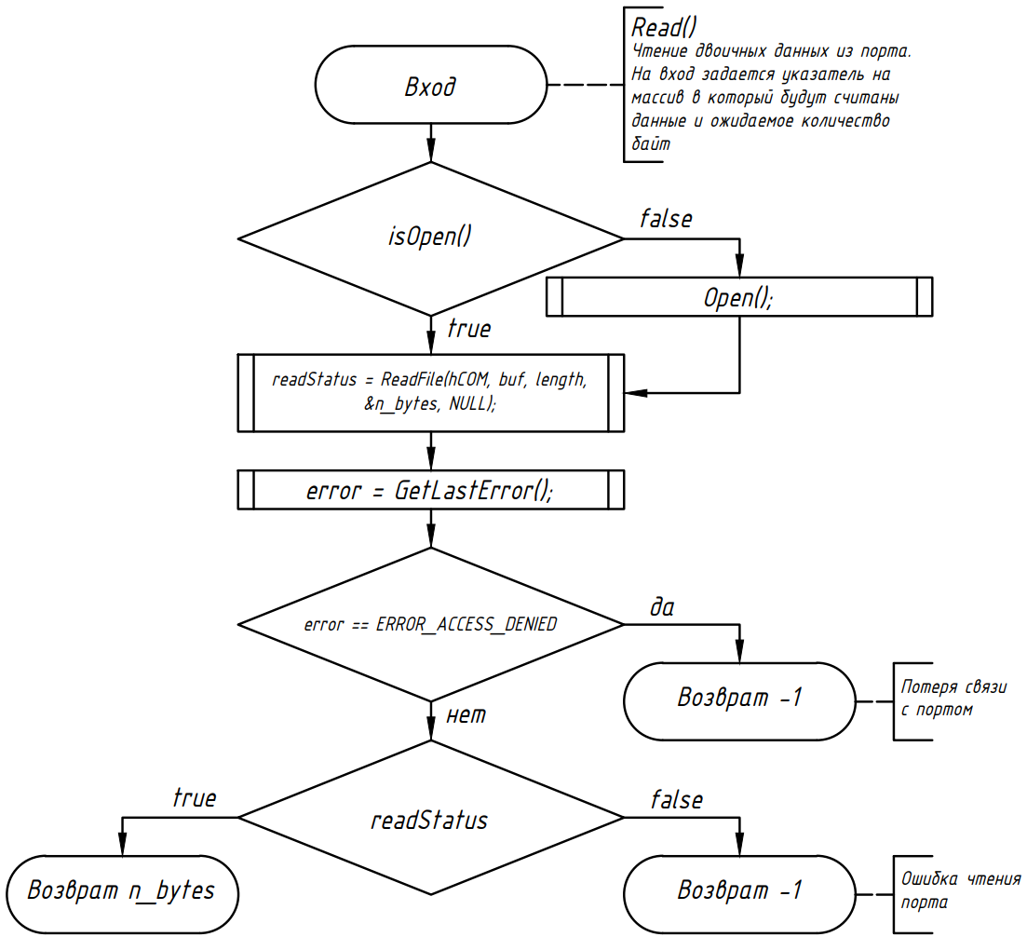
public:
COMPort(
const char* name = "COM3",
unsigned long baud = 9600,
unsigned char dataBit = 8,
char parity = 'N',
unsigned char stopBit = 1);
COMPort(COMPort& other);
COMPort& operator =(COMPort& other);
COMPort(COMPort&& other) noexcept;
COMPort& operator =(COMPort&& other) noexcept;
~COMPort();
bool Open();
bool isOpen();
bool Close();
bool SetConfig(
unsigned long baud = 9600,
unsigned char dataBit = 8,
char parity = 'N',
unsigned char stopBit = 1);
bool SetReadTimeouts(
unsigned long interval = 0,
unsigned long multiplier = 0,
unsigned long constant = 1);
bool ClearReadBuffer();
long Write(unsigned char* buf, unsigned char length);
long Read(unsigned char* buf, unsigned char length);
};

Slide 24
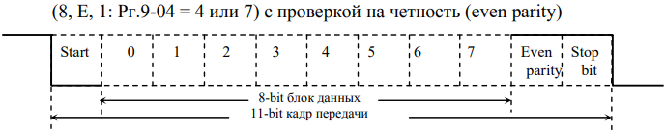
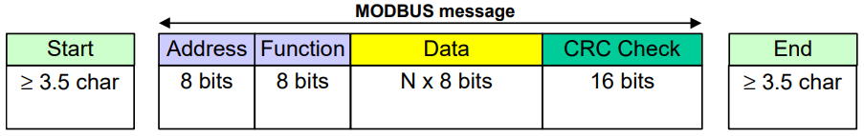
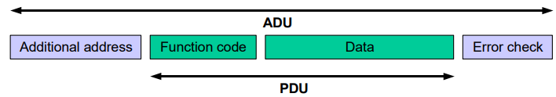
Modbus

Slide 25
Класс Modbus
class ModbusRTUClient
{
private:
#ifdef FAKE_PORT
COMPortFake COM;
#else
COMPort COM;
#endif
unsigned char devAddress;
unsigned char transmitAttempts;
unsigned char wBuf[256];
unsigned char rBuf[256];
unsigned int CRC16(unsigned char* data, unsigned char length);
bool responseCRCCheck(unsigned char pduBytes);
bool Transfer(unsigned char wPDUBytes, unsigned char rPDUBytes);
void PrintException(unsigned int attempt);
public:
#ifdef FAKE_PORT
ModbusRTUClient(unsigned char devAddress = 1,
COMPortFake com = { "COM3", 19200, 8, 'E', 1 });
#else
ModbusRTUClient(unsigned char devAddress = 1,
COMPort com = { "COM3", 19200, 8, 'E', 1 });
#endif
bool ReadHoldingRegisters(
unsigned short startAddress,
unsigned char nRegisters,
unsigned short* buf);
bool WriteSingleRegister(
unsigned short regAddress,
unsigned short regValue);
void SetNumberOfTransmitAttempts(unsigned char attempts = 1);
};
// #define FAKE_PORT
#ifdef FAKE_PORT
#include "COMPortFake.h"
#else
#include "COMPort.h"
#endif

Slide 26
class ModbusRTUClient
{
private:
#ifdef FAKE_PORT
COMPortFake COM;
#else
COMPort COM;
#endif
unsigned char devAddress;
unsigned char transmitAttempts;
unsigned char wBuf[256];
unsigned char rBuf[256];
unsigned int CRC16(unsigned char* data, unsigned char length);
bool responseCRCCheck(unsigned char pduBytes);
bool Transfer(unsigned char wPDUBytes, unsigned char rPDUBytes);
void PrintException(unsigned int attempt);
COM – экземпляр класса последовательного порта;
devAddress – адрес сервера для подключения;
transmitAttempts – общее количество попыток обмена сообщением;
wBuf – буфер, хранящий коммуникационный блок, предназначенный для отправки;
rBuf – буфер, хранящий принятый коммуникационный блок.

Slide 27
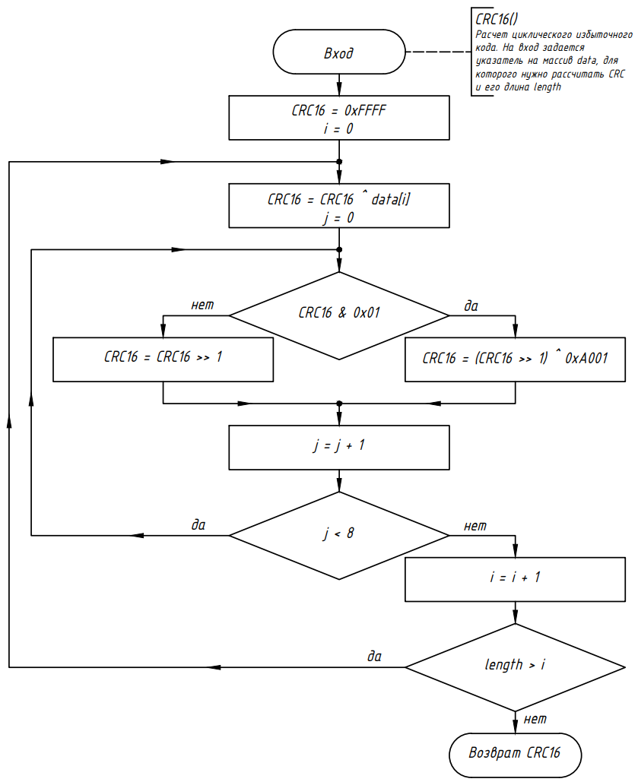
unsigned int CRC16(unsigned char* data, unsigned char length);

Slide 28
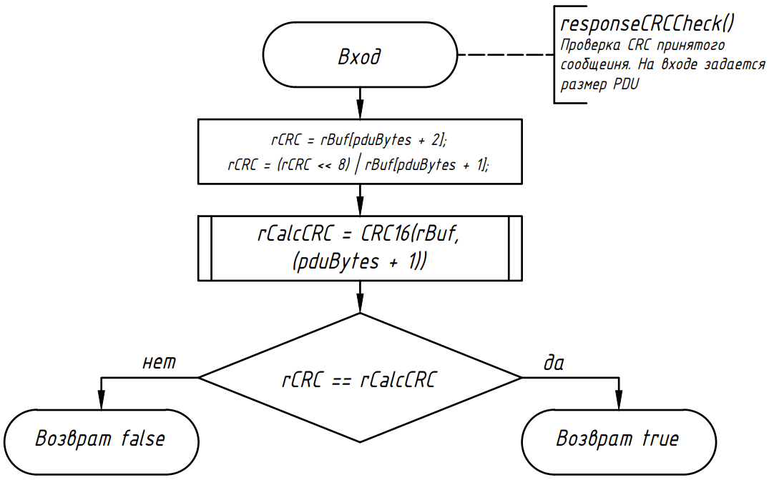
bool responseCRCCheck(unsigned char pduBytes);

Slide 29
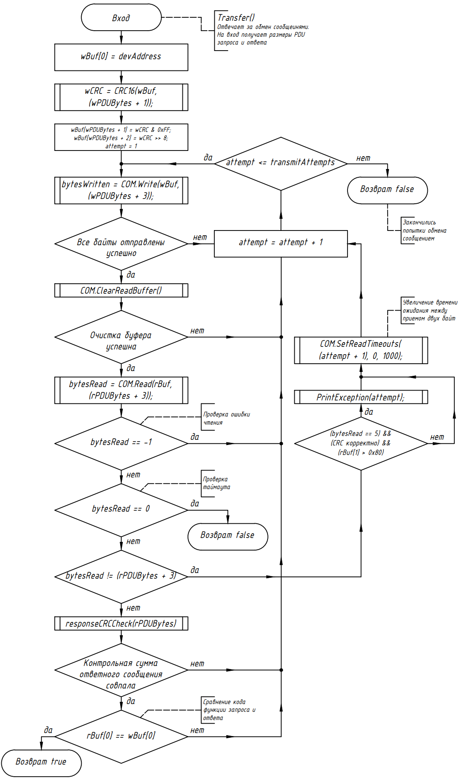
bool Transfer(unsigned char wPDUBytes, unsigned char rPDUBytes);

Slide 30
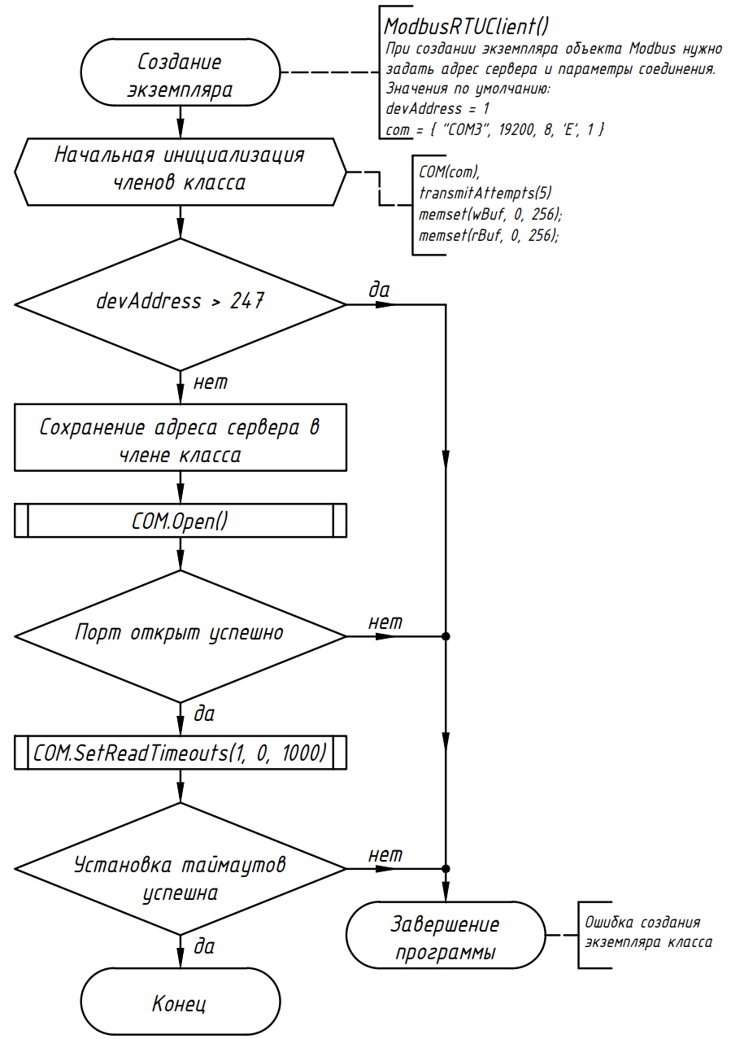
ModbusRTUClient(unsigned char devAddress = 1,
COMPort com = { "COM3", 19200, 8, 'E', 1 });

Slide 31
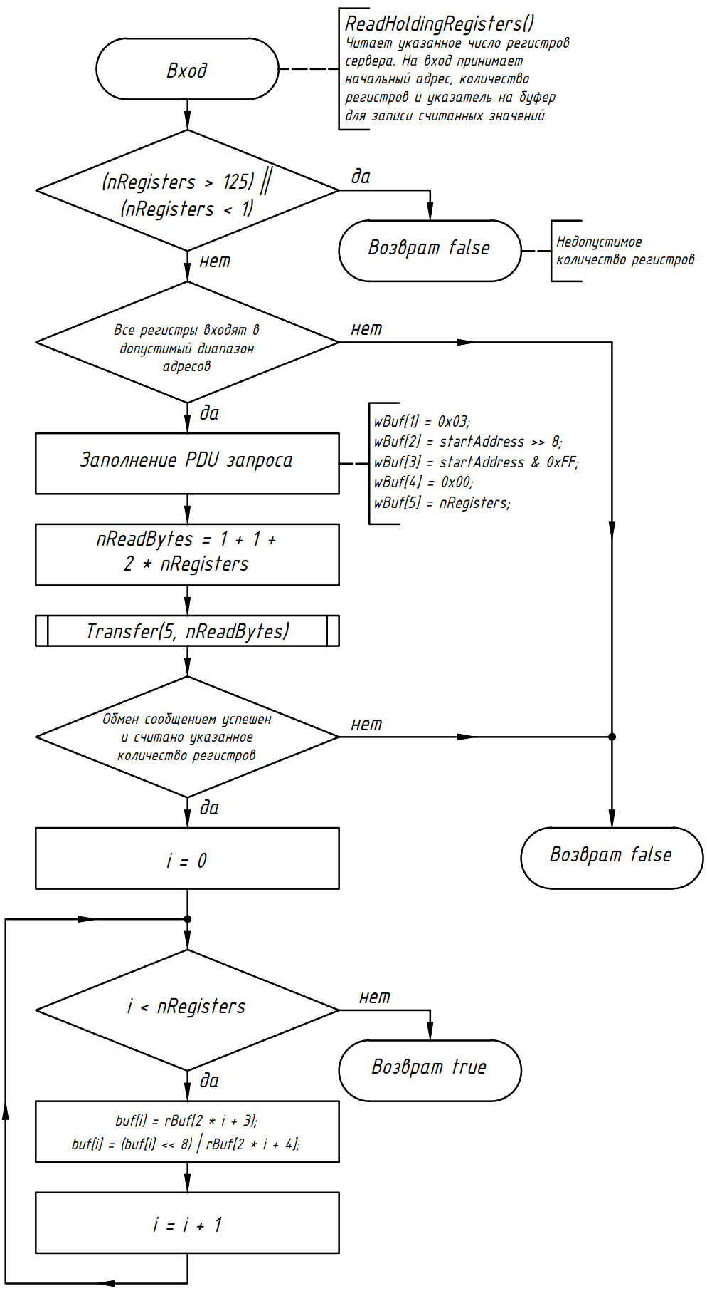
bool ReadHoldingRegisters(
unsigned short startAddress,
unsigned char nRegisters,
unsigned short* buf);

Slide 32
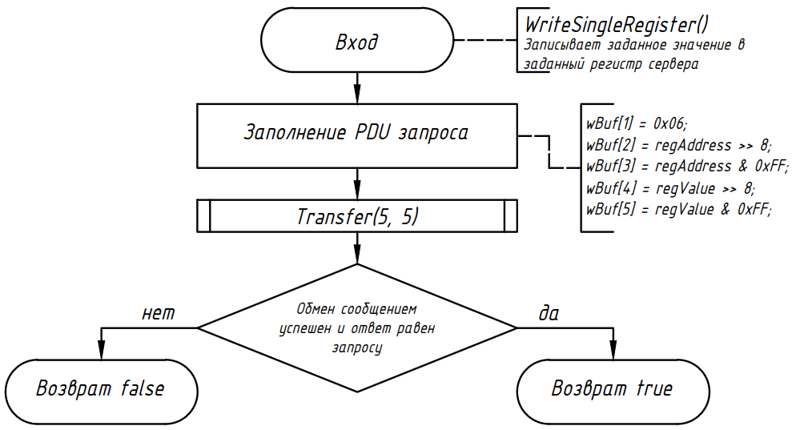
unsigned short* buf);
bool WriteSingleRegister(
unsigned short regAddress,
unsigned short regValue);

Slide 33
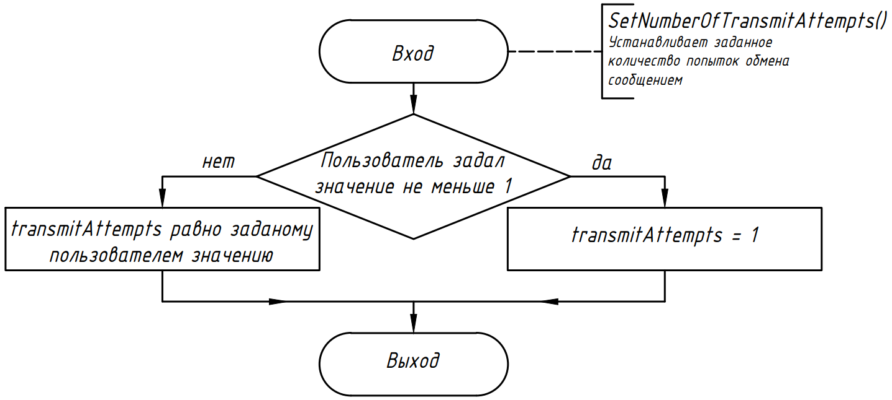
void SetNumberOfTransmitAttempts(unsigned char attempts = 1);

Slide 34
Класс VFD
#include "ModbusRTUClient.h"
typedef struct VFD_status {
struct {
bool RUN;
bool STOP;
bool JOG;
bool FWD;
bool REW;
} LED;
bool F;
bool H;
bool u;
bool controlFrequencyBySerialInterface;
bool controlFrequencyByAnalogSignal;
bool controlVFDBySerialInterface;
bool parametersBlocked;
bool VFDCurrentState;
bool JOGcommand;
} VFD_status_t;
typedef struct VFD_param {
double FrequencyCommand;// 0x2102
double OutFrequency; // 0x2103
double OutCurrent; // 0x2104
double DCVoltage; // 0x2105
double OutVoltage; // 0x2106
double PowerFactor; // 0x210A
double OutTorque; // 0x210B
double MotorSpeed; // 0x210C
} VFD_param_t;

Slide 35
Класс VFD
class VFD
{
private:
ModbusRTUClient MB;
double maxFrequency;
public:
VFD(ModbusRTUClient mb = { 1, {"COM3", 9600, 8, 'E', 1} });
bool Run(unsigned short direction = 0);
bool Stop();
bool ChangeFrequency(
double curFreq = 0,
double newFreq = 50,
double changeTime = 1);
bool ReadParameterRegisters(VFD_status_t* status, VFD_param_t* param);
bool GetOutPower(double* power);
bool GetVFDTemperature(double* temp);
bool ReadMaxFrequency(double* maxFreq = nullptr);
bool SetFrequency(double freq);
bool SetAccelerationTime(double time);
bool SetDecelerationTime(double time);
bool SetWatchdog(double time = 0);
bool GetParam(unsigned short addr, unsigned short* val);
bool SetParam(unsigned short addr, unsigned short val);
};
MB – экземпляр класса Modbus клиента;
maxFrequency – максимальная выходная частота ПЧ. По умолчанию задано 50 Гц, также есть возможность считать ее как значение параметра 01-00.

Slide 36
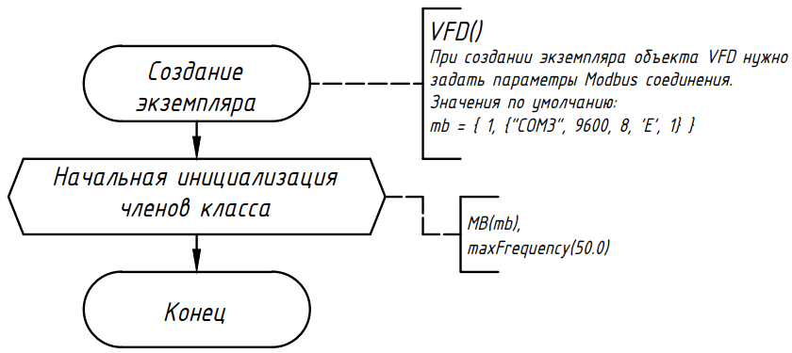
class VFD
{
private:
ModbusRTUClient MB;
double maxFrequency;
public:
VFD(ModbusRTUClient mb = { 1, {"COM3", 9600, 8, 'E', 1} });
bool Run(unsigned short direction = 0);
bool Stop();
bool ChangeFrequency(
double curFreq = 0,
double newFreq = 50,
double changeTime = 1);
bool ReadParameterRegisters(VFD_status_t* status, VFD_param_t* param);
bool GetOutPower(double* power);
bool GetVFDTemperature(double* temp);
bool ReadMaxFrequency(double* maxFreq = nullptr);
bool SetFrequency(double freq);
bool SetAccelerationTime(double time);
bool SetDecelerationTime(double time);
bool SetWatchdog(double time = 0);
bool GetParam(unsigned short addr, unsigned short* val);
bool SetParam(unsigned short addr, unsigned short val);
};

Slide 37
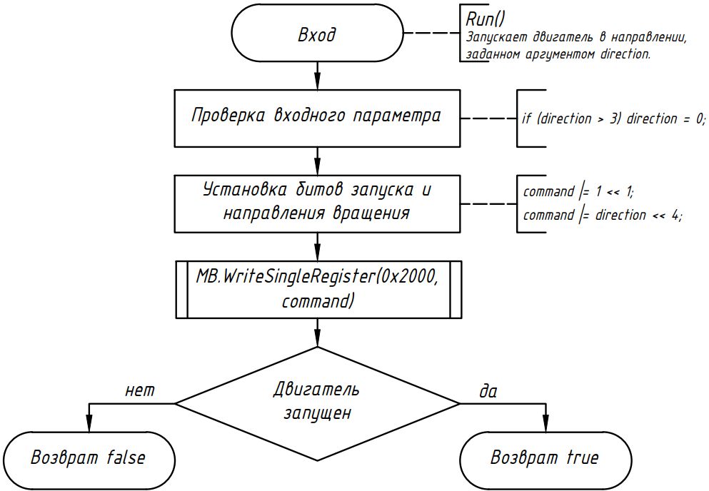
class VFD
{
private:
ModbusRTUClient MB;
double maxFrequency;
public:
VFD(ModbusRTUClient mb = { 1, {"COM3", 9600, 8, 'E', 1} });
bool Run(unsigned short direction = 0);
bool Stop();
bool ChangeFrequency(
double curFreq = 0,
double newFreq = 50,
double changeTime = 1);
bool ReadParameterRegisters(VFD_status_t* status, VFD_param_t* param);
bool GetOutPower(double* power);
bool GetVFDTemperature(double* temp);
bool ReadMaxFrequency(double* maxFreq = nullptr);
bool SetFrequency(double freq);
bool SetAccelerationTime(double time);
bool SetDecelerationTime(double time);
bool SetWatchdog(double time = 0);
bool GetParam(unsigned short addr, unsigned short* val);
bool SetParam(unsigned short addr, unsigned short val);
};

Slide 38
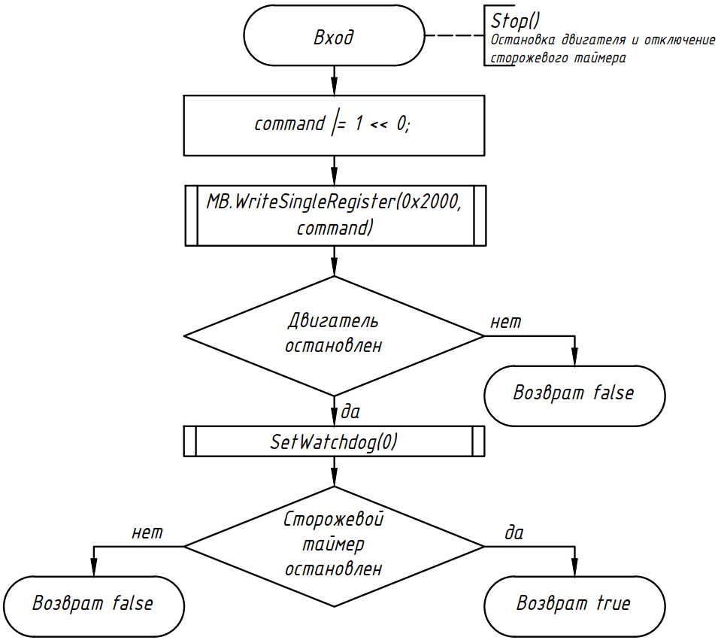
class VFD
{
private:
ModbusRTUClient MB;
double maxFrequency;
public:
VFD(ModbusRTUClient mb = { 1, {"COM3", 9600, 8, 'E', 1} });
bool Run(unsigned short direction = 0);
bool Stop();
bool ChangeFrequency(
double curFreq = 0,
double newFreq = 50,
double changeTime = 1);
bool ReadParameterRegisters(VFD_status_t* status, VFD_param_t* param);
bool GetOutPower(double* power);
bool GetVFDTemperature(double* temp);
bool ReadMaxFrequency(double* maxFreq = nullptr);
bool SetFrequency(double freq);
bool SetAccelerationTime(double time);
bool SetDecelerationTime(double time);
bool SetWatchdog(double time = 0);
bool GetParam(unsigned short addr, unsigned short* val);
bool SetParam(unsigned short addr, unsigned short val);
};

Slide 39
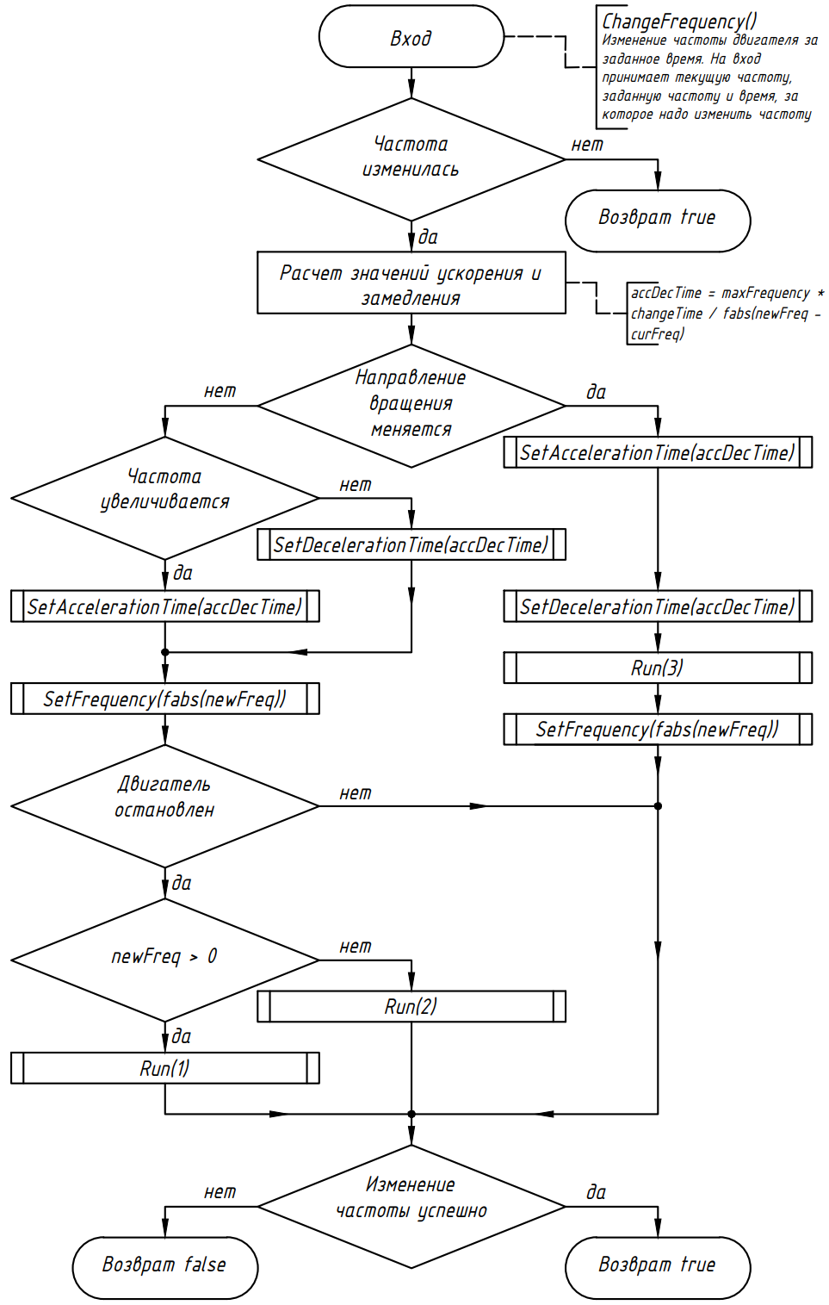
class VFD
{
private:
ModbusRTUClient MB;
double maxFrequency;
public:
VFD(ModbusRTUClient mb = { 1, {"COM3", 9600, 8, 'E', 1} });
bool Run(unsigned short direction = 0);
bool Stop();
bool ChangeFrequency(
double curFreq = 0,
double newFreq = 50,
double changeTime = 1);
bool ReadParameterRegisters(VFD_status_t* status, VFD_param_t* param);
bool GetOutPower(double* power);
bool GetVFDTemperature(double* temp);
bool ReadMaxFrequency(double* maxFreq = nullptr);
bool SetFrequency(double freq);
bool SetAccelerationTime(double time);
bool SetDecelerationTime(double time);
bool SetWatchdog(double time = 0);
bool GetParam(unsigned short addr, unsigned short* val);
bool SetParam(unsigned short addr, unsigned short val);
};

Slide 40
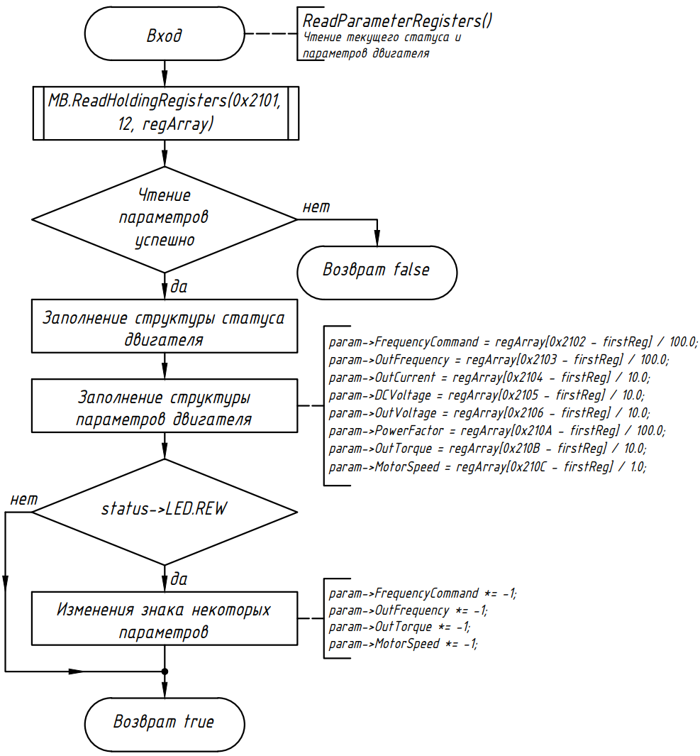
class VFD
{
private:
ModbusRTUClient MB;
double maxFrequency;
public:
VFD(ModbusRTUClient mb = { 1, {"COM3", 9600, 8, 'E', 1} });
bool Run(unsigned short direction = 0);
bool Stop();
bool ChangeFrequency(
double curFreq = 0,
double newFreq = 50,
double changeTime = 1);
bool ReadParameterRegisters(VFD_status_t* status, VFD_param_t* param);
bool GetOutPower(double* power);
bool GetVFDTemperature(double* temp);
bool ReadMaxFrequency(double* maxFreq = nullptr);
bool SetFrequency(double freq);
bool SetAccelerationTime(double time);
bool SetDecelerationTime(double time);
bool SetWatchdog(double time = 0);
bool GetParam(unsigned short addr, unsigned short* val);
bool SetParam(unsigned short addr, unsigned short val);
};

Slide 41
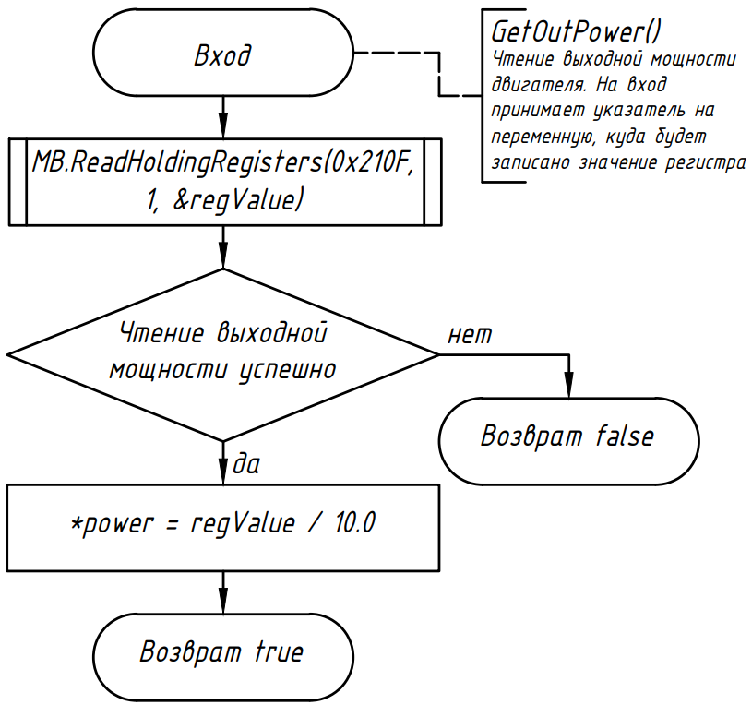
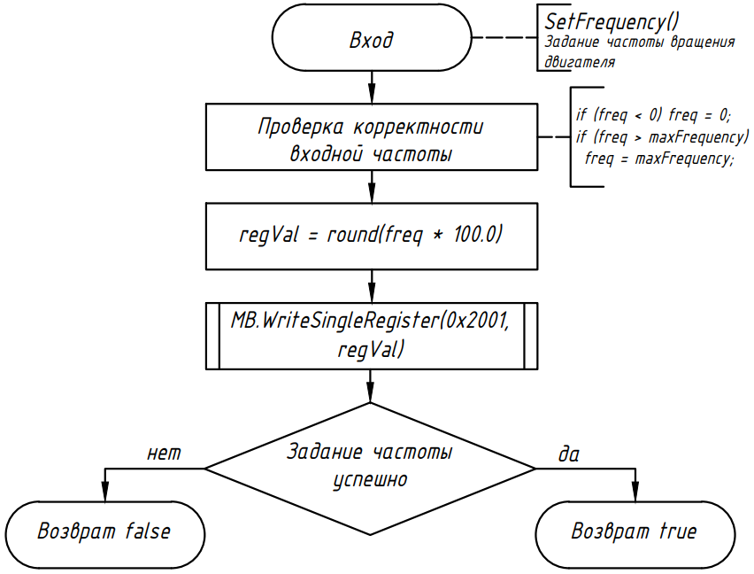
class VFD
{
private:
ModbusRTUClient MB;
double maxFrequency;
public:
VFD(ModbusRTUClient mb = { 1, {"COM3", 9600, 8, 'E', 1} });
bool Run(unsigned short direction = 0);
bool Stop();
bool ChangeFrequency(
double curFreq = 0,
double newFreq = 50,
double changeTime = 1);
bool ReadParameterRegisters(VFD_status_t* status, VFD_param_t* param);
bool GetOutPower(double* power);
bool GetVFDTemperature(double* temp);
bool ReadMaxFrequency(double* maxFreq = nullptr);
bool SetFrequency(double freq);
bool SetAccelerationTime(double time);
bool SetDecelerationTime(double time);
bool SetWatchdog(double time = 0);
bool GetParam(unsigned short addr, unsigned short* val);
bool SetParam(unsigned short addr, unsigned short val);
};

Slide 42
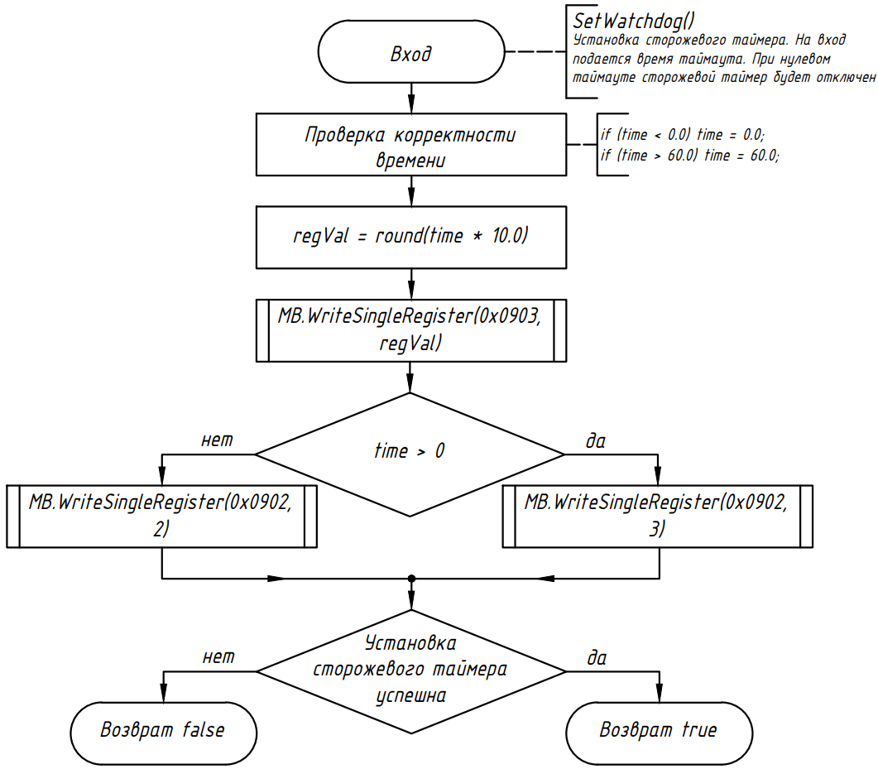
class VFD
{
private:
ModbusRTUClient MB;
double maxFrequency;
public:
VFD(ModbusRTUClient mb = { 1, {"COM3", 9600, 8, 'E', 1} });
bool Run(unsigned short direction = 0);
bool Stop();
bool ChangeFrequency(
double curFreq = 0,
double newFreq = 50,
double changeTime = 1);
bool ReadParameterRegisters(VFD_status_t* status, VFD_param_t* param);
bool GetOutPower(double* power);
bool GetVFDTemperature(double* temp);
bool ReadMaxFrequency(double* maxFreq = nullptr);
bool SetFrequency(double freq);
bool SetAccelerationTime(double time);
bool SetDecelerationTime(double time);
bool SetWatchdog(double time = 0);
bool GetParam(unsigned short addr, unsigned short* val);
bool SetParam(unsigned short addr, unsigned short val);
};

Slide 43
Основная программа (main)
Консольное приложение
Взаимодействие через аргументы командной строки
Обмен данными через файл
int main(int argc, char *argv[])

Slide 44
Help.
This program can control Delta VFD-B.
Input commandline arguments:
-h | --help Display this help message
--port <COMx> Specify serial port (COM3 default) (--port COM3)
--file <text_file> Read a file with frequency and time parameters table. (--file coords.txt)
And run motor according to the table.
Text file should contain table with times and frequencies and should look like this:
Time Frequency
0 0
10 30
20 20
40 -10
50 0
(The first column specifies the time to be set.
The second column specifies the frequency that will be reached for the time,
specified in the first column.)

Slide 45
--get <parameter> Read one of the following motor parameters: (--get MotorSpeed)
<FrequencyCommand>
<OutFrequency>
<OutCurrent>
<DCVoltage>
<OutVoltage>
<PowerFactor>
<OutTorque>
<MotorSpeed>
<OutPower>
<VFDTemperature>
<0x(parameter address)> (--get 0x0109)
--set <parameter> <value> Set one of the folloving motor parameters: (--set Frequency 45.5)
<Frequency>
<AccelerationTime>
<DecelerationTime>
<0x(parameter address)> (--set 0x2001 0x1388)
--run <n|f|r|c> Run motor with direction set (no change, forvard, reverse, change) (--run r)
--stop Stop motor

Slide 46
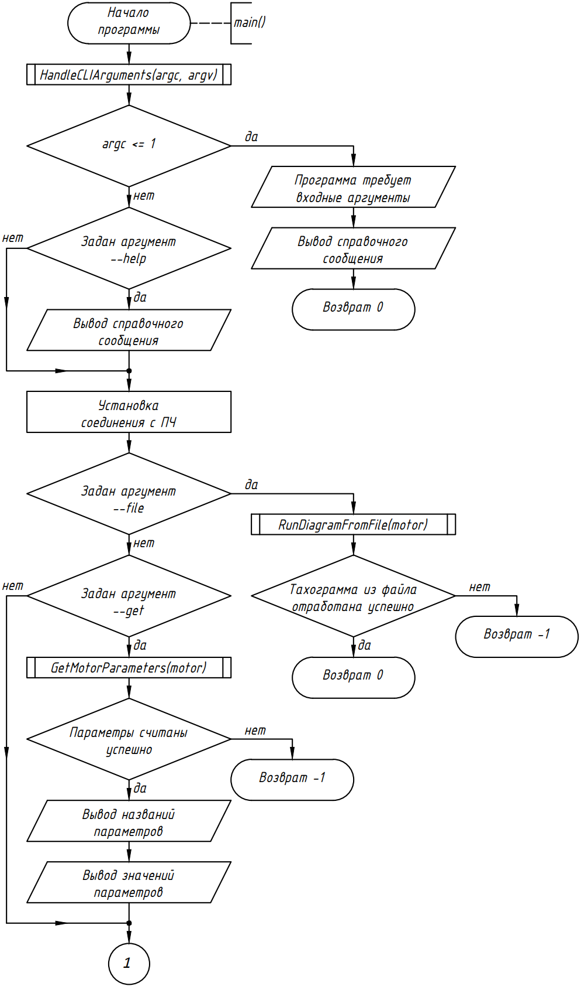
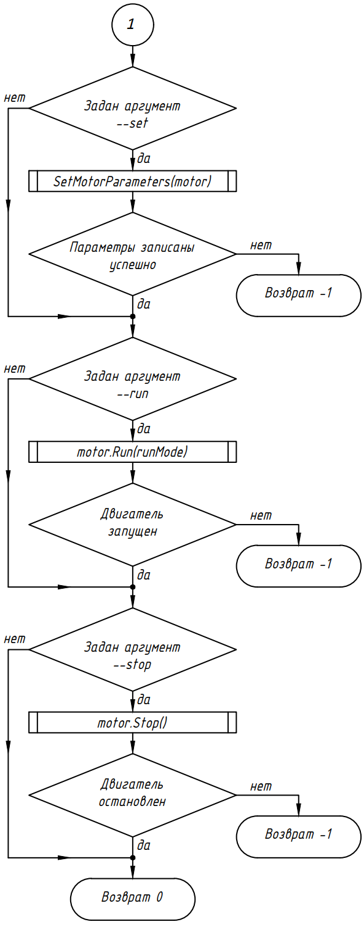

Slide 47
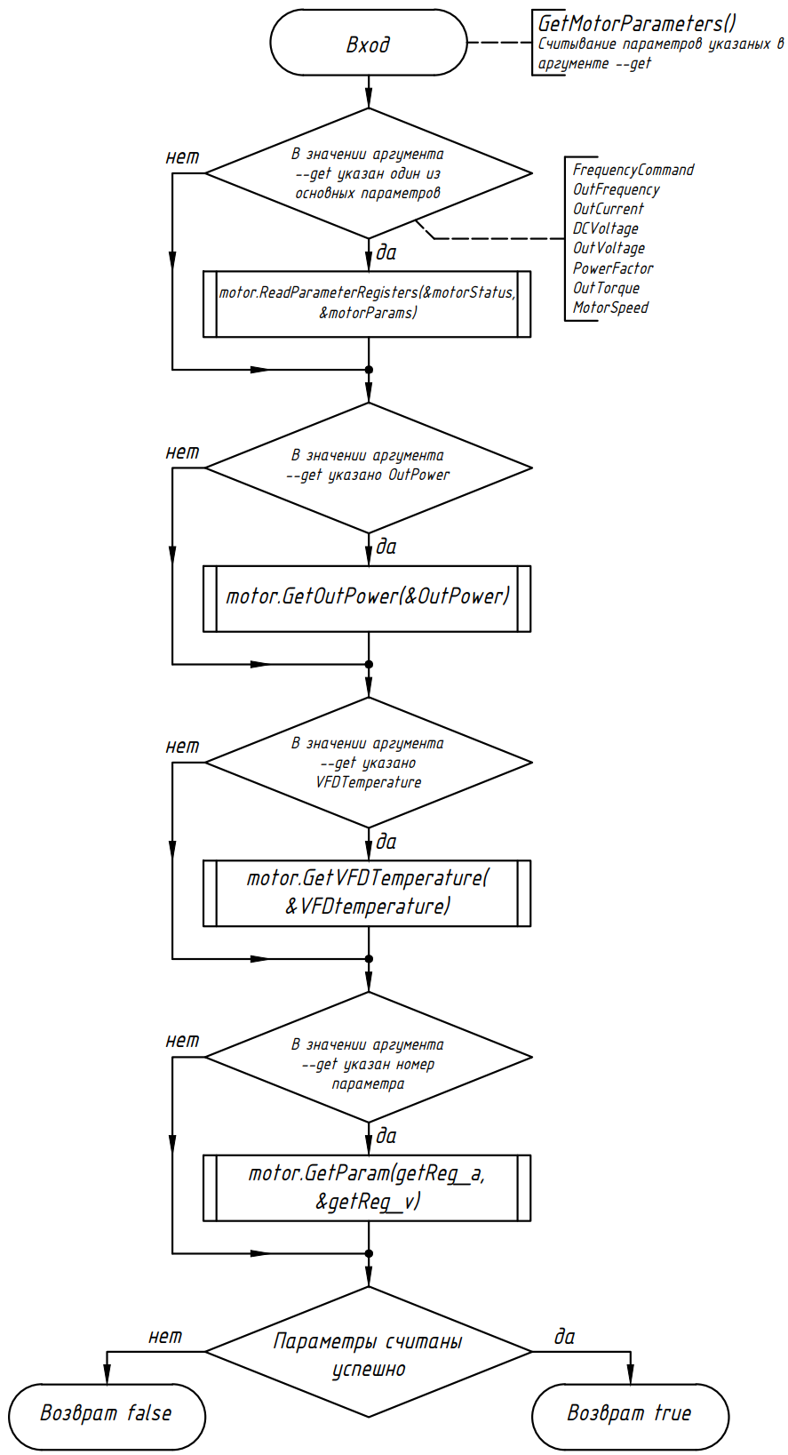
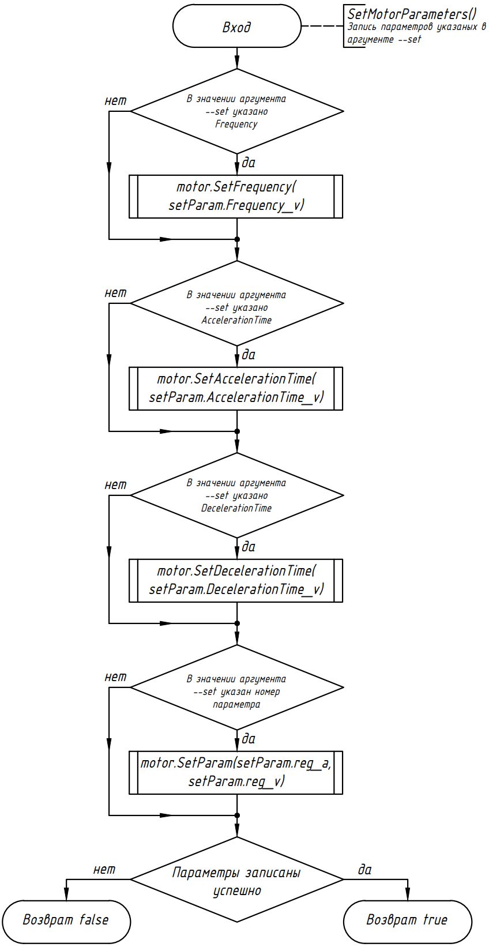

Slide 48
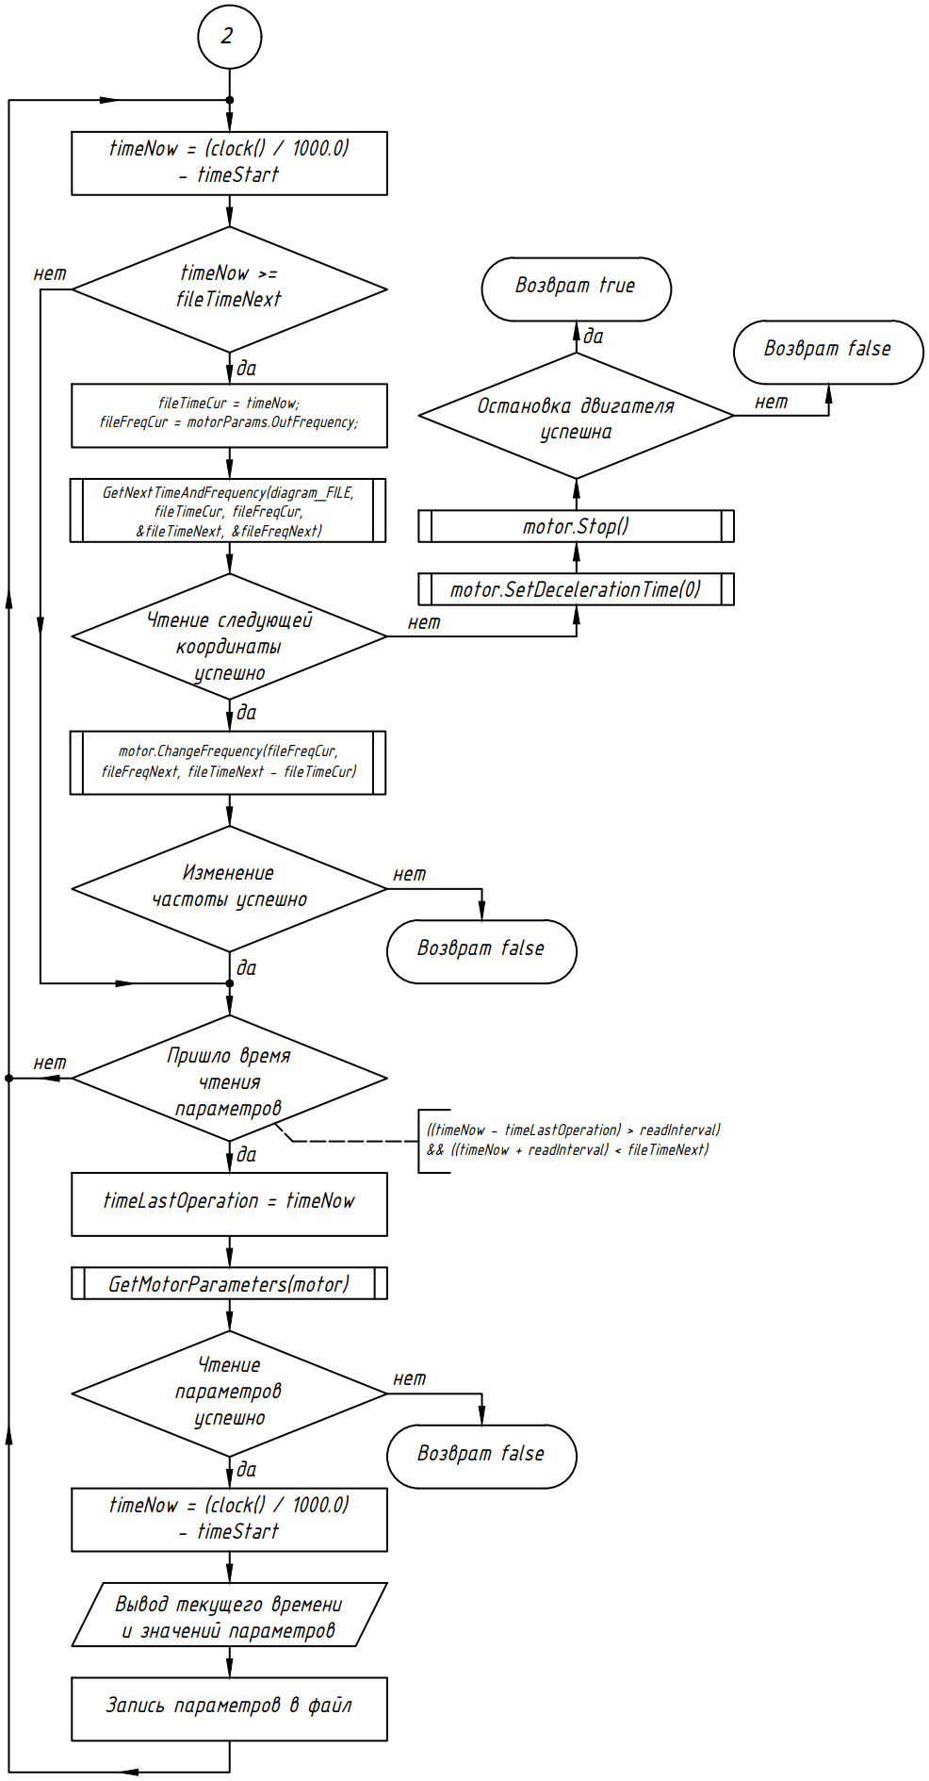
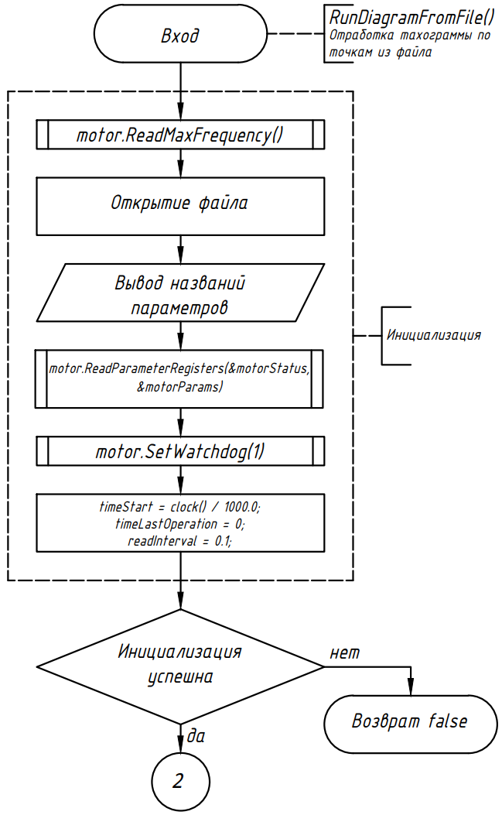
bool RunDiagramFromFile(VFD& motor);

Slide 49
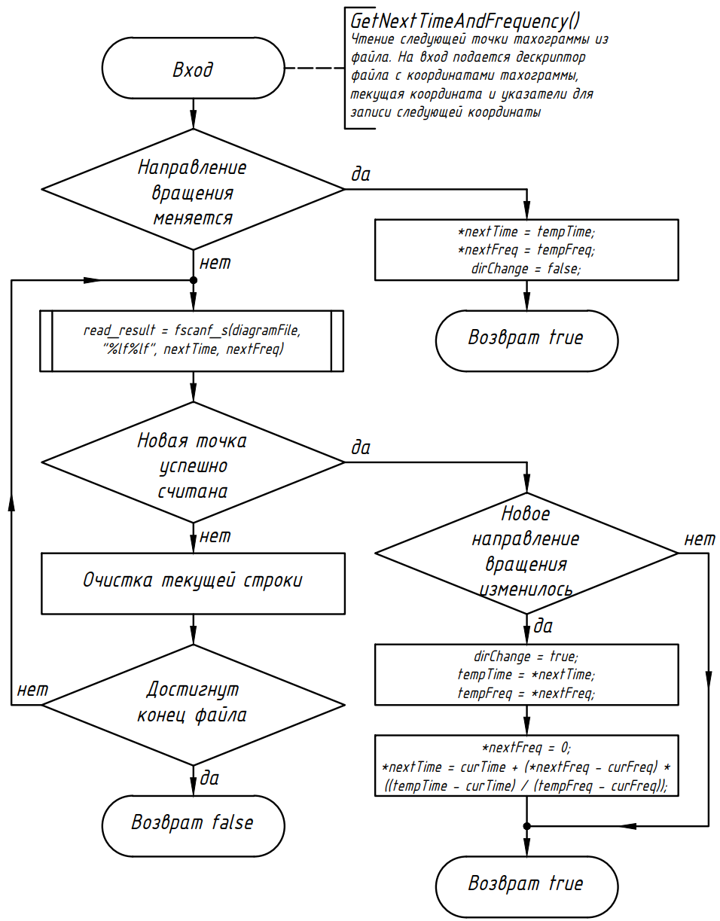
bool GetNextTimeAndFrequency(FILE* diagramFile,
double curTime, double curFreq,
double* nextTime, double* nextFreq);

Slide 50
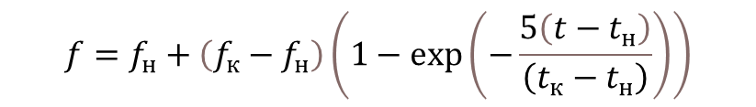
Time Frequency
0 0
0.5 11.06
1 19.67
1.5 26.38
2 31.61
2.5 35.67
3 38.84
3.5 41.31
4 43.23
4.5 44.73
5 45.9
5.5 46.8
6 47.51
6.5 48.06
7 48.49
7.5 48.82
8 49.08
8.5 49.29
9 49.44
9.5 49.57
10 49.66
12 10
14 10
16 -20
18 -20
19 -40
21 -40
24 0
$$f=f_{н}+\left(f_{к}−f_{н}\right)\left(1−\exp\left(−\frac{5\left(t−t_{н}\right)}{\left(t_{к}−t_{н}\right)}\right)\right)$$
VFDMotorControlWindows.exe --port COM9 --file coords.txt --get OutFrequency --get OutCurrent --get OutVoltage --get MotorSpeed > outRes.txt

Slide 51

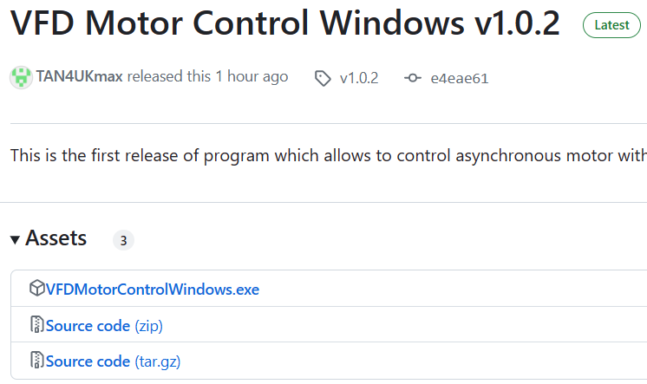
Продолжение следует…
https://github.com/TAN4UKmax/microcontrollersCourseWork
https://www.linkedin.com/in/tan4uk/

